Slide 1
Toy company performance analysis for 2023

Slide 2
Agenda
Introduction
Overall Performance Analysis
Detailed performance analysis
By categories
According to the sites
By products
Main challenges
Recommendations
Future business plan
Conclusion

Slide 3
Introduction
The toy company aims to provide innovative, high-quality products to attract customers and achieve growth. The current analysis focuses on reviewing performance to date and identifying opportunities for improvement to achieve annual goals.

Slide 4
Overall Performance Analysis
Total revenue to date: $6.96 million.
Percentage of progress towards the annual goal: 81.9%.
Monthly revenue performance shows positive growth with some seasonal fluctuations.
The percentage of progress towards the interactive target ($9 million) reached 103.9%, which indicates that overall performance is moving towards achieving and perhaps exceeding the targets.

Slide 5
Detailed Analysis

Slide 6
Performance by categories
The Art & Crafts category saw an impressive growth of 251.9%.
Other categories such as sports & outdoor and toys had moderate growth.
The Electronics category performed poorly, with a decline of 27.8%.
Toys are the most contributing category ($2.3 million), followed by crafts ($1.8 million).
251.9%
25.1%
20.3%
14.2%
-27.8%

Slide 7
Performance by location
Airports had the highest growth at 37.5%, followed by locations in Downtown areas at 33.4%.
Shopping malls: stable performance, need to increase focus on promotion.
Some stores have very limited days of available inventory for high-demand products, such as Lego Bricks and Dino Eggs, indicating challenges with inventory management.
Some stores such as “Culiacan 1” and “Puebla 1” achieve high annual growth of more than 90%.
37.5%
33.4%
25.2%
24.8%

Slide 8
Performance by products
Top performing products:
Magic Sand: growth +24825%.
Mr. Potatohead: growth +5473.9%.
Lowest performing products:
Playfoam: down -100%.
Other product had moderate growth.
Some products, such as Playfoam and Foam Disc Launcher, decreased in sales

Slide 9
Key Challenges
Electronics category underperformed by - 27.8%.
Some products like Playfoam need a thorough review to improve sales.
Over-reliance on specific locations such as the airport.

Slide 10
Recommendations
Promoting investment in successful products such as Magic Sand and Mr. Potatohead.
Develop new products to compensate for Playfoam's poor performance.
Increased promotion of the electronics category, while improving product design.
Expand into locations that have shown growth potential such as downtown.
Improving seasonal planning strategies to exploit peak periods.
Reduce low inventory days by optimizing the supply chain and ensuring a continuous flow of products to stores.
Based on local demand, expand assortment in locations that show high demand for specific categories such as airports.

Slide 11
Conclusion
The company is making good progress towards its goals but there are still opportunities to improve performance in some categories and locations. By improving inventory management and investing resources in high-performing categories and locations, the company can achieve greater growth and improve operational efficiency.

Slide 12
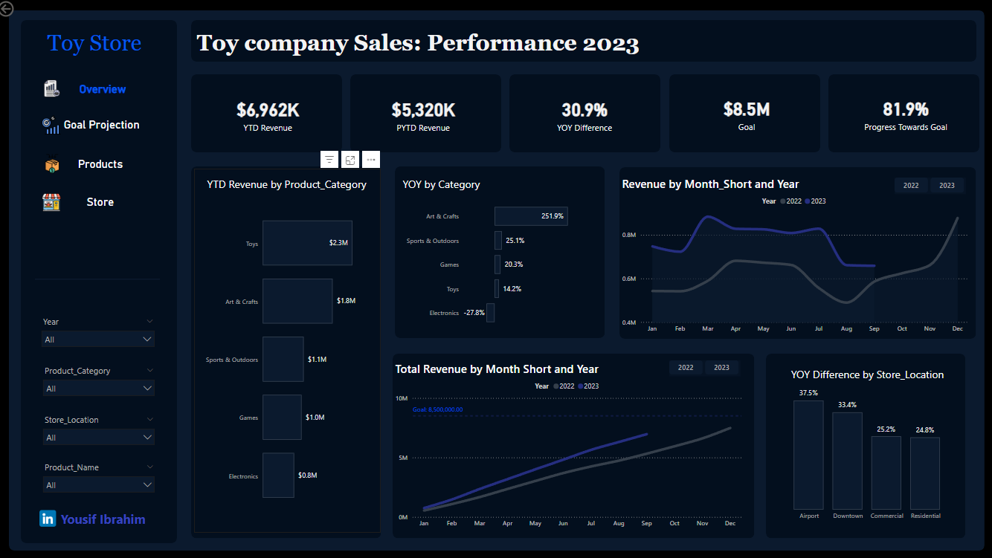

Slide 13
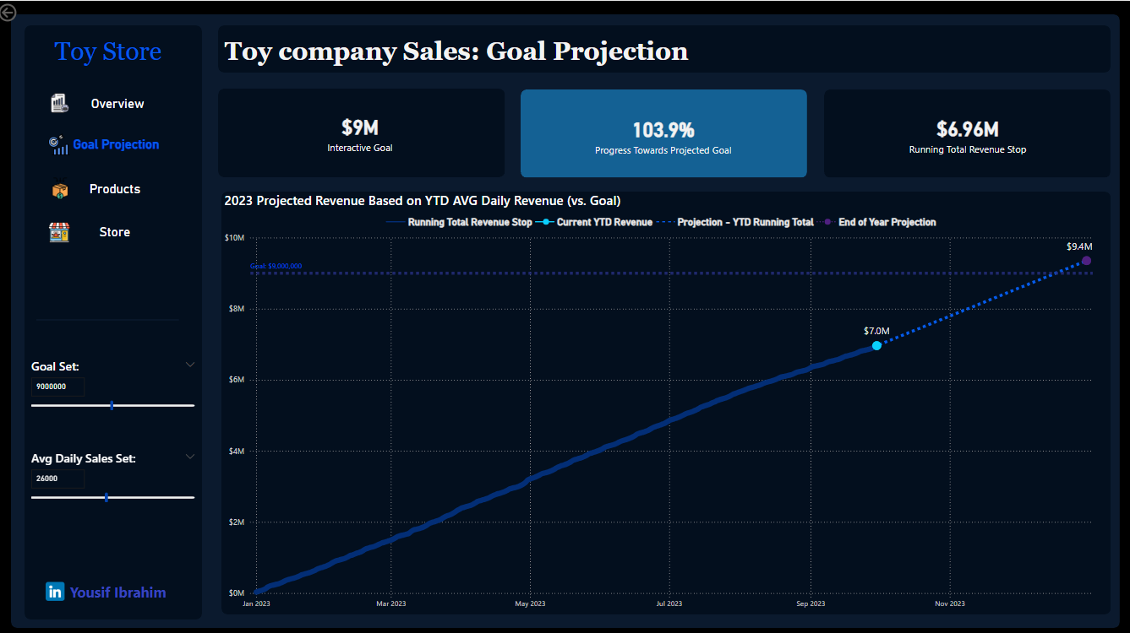

Slide 14
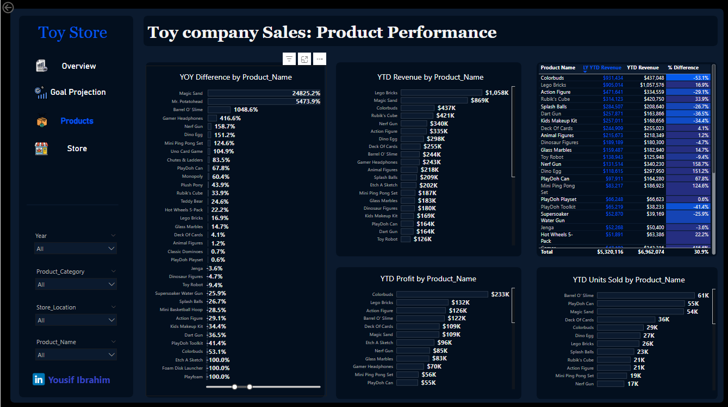

Slide 15
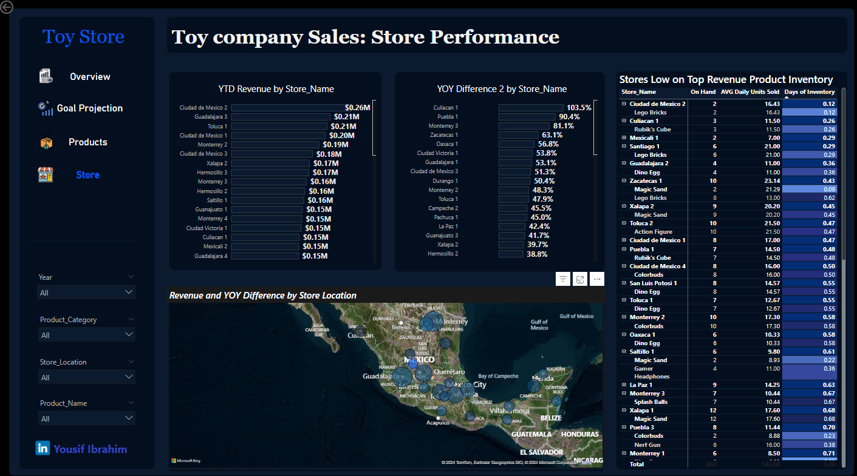

Slide 16
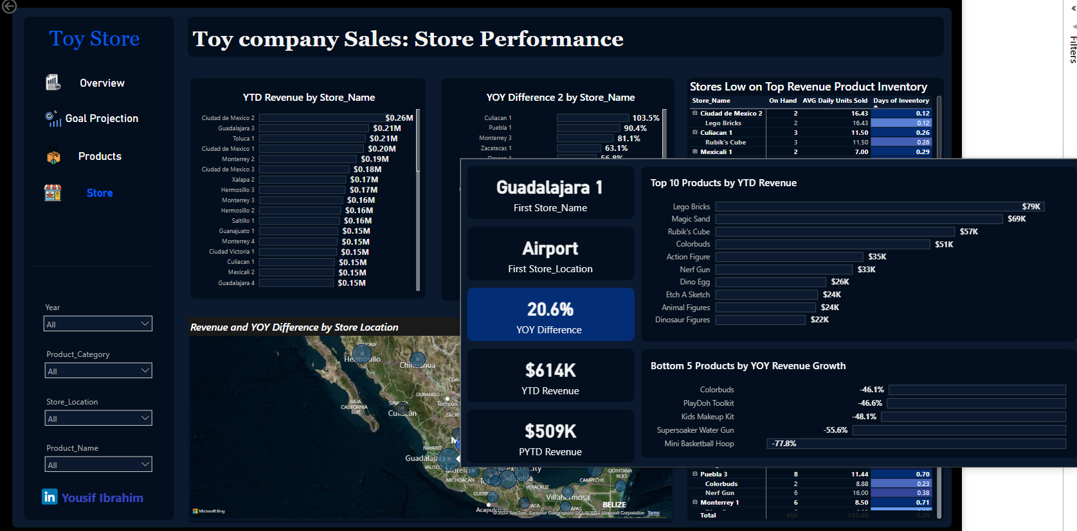

Slide 17


Slide 18
Thank you
Yousif Ibrahim
Project Link:Toy Store Sales - Power BI
yosefys236@gmail.com
LinkedIn

